Slide 1
Clinical Sequencing Initiative: Phenotype Analysis, VCF Concordance
Vasu Kuram

Slide 2
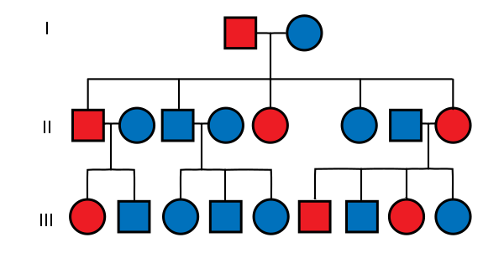
Cohort
Primary Immunodeficiency (PID) patients & family
2054 samples with sequencing data received + processed
1494 probands
1224 have Human Phenotype Ontology data on file
Notes:
CSI’s aim is to “sequence everyone who walks through the door”
This is a growing data resource for NIAID Intramural research and it has full data on family members in addition to the proband
HPO data comes from clinical notes which are stored in the CRIMSON database. Then the BCBB team helps annotate the medical record with HPO terms.

Slide 3
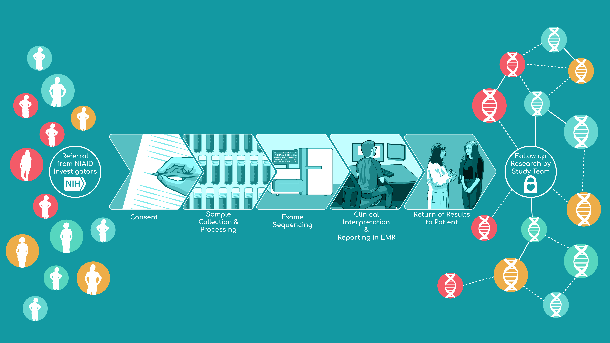
Clinical Sequencing Initiative (CSI) Workflow
NCBR
Notes:
The Clinical Sequencing Initiative involves many different teams of people.
Consent:
NIAID Clinicians refer patients
Genetic Counselors consent the patients
Sample Collection & Processing:
NIH Staff help collect samples (mainly saliva, some whole blood)
DLM gets sample orders ready to send to sequencing
Exome Sequencing:
JHU Center for Inherited Disease Research (CIDR) has been doing most of the sequencing…will be done after Batch 24
Baylor College of Medicine will be doing sequencing going forward
Sanger validation on some patients is done by Sanger CLIA at the DLM
Clinical Interpretation:
Clinical Molecular Geneticists use GRIS, developed by BCBB (I’ll show on the next slide)
Return of results to patient:
Genetic Counselors and Molecular Geneticists

Slide 4
CSI Batch Processing
We receive ~100 samples every month from the sequencing facility
Download/unpack the data
Run QC
Run CNV, SNP calling
Run HLA Typing
VCF Concordance check (just added)
Convert from order ID to Phenotips ID for QC/VCF/BAM/CNV
Create pedigree files for Seqr and Phenotips
Notes:
Currently we have three processing pipelines for CSI data:
CIDR: CRAM -> BAM, subset msVCF
Baylor: Everything from BAMs
Hg38 pipeline for future Seqr 2.0
The results of this processing get uploaded to GRIS
The BCBB team made a convenient way to allow the CSI team to view family variant data along with database annotations and phenotypic information all in one place

Slide 5
Primary Immunodeficiency (PID)
PID consists of ~130 disorders that result from defects in immune system development/function
Mostly rare (1 in 1200 live births)
Broadly categorized into adaptive and innate disorders
Many patients exhibit chronic but generic symptoms:
sinusitis, bronchitis, and pneumonia
60% of patients aren’t diagnosed until adulthood
McCusker, Christine et al. “Primary immunodeficiency.” Allergy, asthma, and clinical immunology : official journal of the Canadian Society of Allergy and Clinical Immunology vol. 14,Suppl 2 61. 12 Sep. 2018, doi:10.1186/s13223-018-0290-5
Notes:
- Adaptive disorders:
T cell and B cell disorders
Innate disorders:
Phagocyte and complement defects

Slide 6
Research opportunities
The cohort is too small for GWAS
Only exome data
Can’t do burden testing, no control set
Exploring phenotypic terms:
See if there are phenotypic terms that are significantly associated with specific gene mutations
Notes:
Cohort is a little too small for GWAS
Can’t do burden testing b/c of this, and there’s no disease free control set (don’t want to use some publicly available dataset)

Slide 7

HPO: Human Phenotype Ontology
Standardized vocabulary of phenotypic abnormalities related to human disease
~13,000 terms and ~156,000 disease annotations
Uses medical literature, Orphanet, DECIPHER, OMIM
Notes:
Developed by NIH funded Monarch Initiative.
Hierarchical structure, annotated with gene associations and OMIM disease IDs

Slide 8
Linking Phenotype to Mutation
Gene | Term | HPO ID | Subject Count | Family Count
NLRP3 | Skin rash | HP:0000988 | 21 | 19
VPS13B | Asthma | HP:0002099 | 19 | 19
VPS13B | Fatigue | HP:0012378 | 18 | 18
ATM | Allergic rhinitis | HP:0003193 | 18 | 18
RYR1 | Fatigue | HP:0012378 | 16 | 16
FAS | Splenomegaly | HP:0001744 | 16 | 16
ATM | Asthma | HP:0002099 | 17 | 16
NLRP3 | Fever | HP:0001945 | 15 | 15
VPS13B | Skin rash | HP:0000988 | 15 | 15
…

Slide 9
Linking Phenotype to Mutation
Gene | Term | HPO ID | Subject Count | Family Count
NLRP3 | Skin rash | HP:0000988 | 21 | 19
VPS13B | Asthma | HP:0002099 | 19 | 19
VPS13B | Fatigue | HP:0012378 | 18 | 18
ATM | Allergic rhinitis | HP:0003193 | 18 | 18
RYR1 | Fatigue | HP:0012378 | 16 | 16
FAS | Splenomegaly | HP:0001744 | 16 | 16
ATM | Asthma | HP:0002099 | 17 | 16
NLRP3 | Fever | HP:0001945 | 15 | 15
VPS13B | Skin rash | HP:0000988 | 15 | 15
…
Notes:
Suuuuuper preliminary
This spreadsheet shows simple counts of how many people with a mutation in Gene X have an HPO Term Y.
Methods:
Took all variant information downloaded from Seqr, which is a collaborative portal that stores all pedigree info, variant info, manual clinical annotations, and automatic database annotations in one place
Filtered out ”synonymous variants” variants
Only kept variants with a frequency of 0.0 in gnomAD, 1000 genomes WG, and Exac V3
Then, I only kept variant for which the gene was shared across 3 or more families
This is showing simple counts. We need statistical power. Some of these HPO terms may be so commonplace that they’re showing up in every one
It’s hard to see an actual association between a term and a mutation in the gene

Slide 10
Linking Phenotype to Mutation
Gene | Term | HPO ID | Subject Count | Family Count
NLRP3 | Skin rash | HP:0000988 | 21 | 19
VPS13B | Asthma | HP:0002099 | 19 | 19
VPS13B | Fatigue | HP:0012378 | 18 | 18
ATM | Allergic rhinitis | HP:0003193 | 18 | 18
RYR1 | Fatigue | HP:0012378 | 16 | 16
FAS | Splenomegaly | HP:0001744 | 16 | 16
ATM | Asthma | HP:0002099 | 17 | 16
NLRP3 | Fever | HP:0001945 | 15 | 15
VPS13B | Skin rash | HP:0000988 | 15 | 15
…
Notes:
Suuuuuper preliminary
This spreadsheet shows simple counts of how many people with a mutation in Gene X have an HPO Term Y.
Methods:
Took all variant information downloaded from Seqr, which is a collaborative portal that stores all pedigree info, variant info, manual clinical annotations, and automatic database annotations in one place
Filtered out ”synonymous variants” variants
Only kept variants with a frequency of 0.0 in gnomAD, 1000 genomes WG, and Exac V3
Then, I only kept variant for which the gene was shared across 3 or more families
This is showing simple counts. We need statistical power. Some of these HPO terms may be so commonplace that they’re showing up in every one
It’s hard to see an actual association between a term and a mutation in the gene

Slide 11
Linking Phenotype to Mutation
Gene | Term | HPO ID | Subject Count | Family Count
NLRP3 | Skin rash | HP:0000988 | 21 | 19
VPS13B | Asthma | HP:0002099 | 19 | 19
VPS13B | Fatigue | HP:0012378 | 18 | 18
ATM | Allergic rhinitis | HP:0003193 | 18 | 18
RYR1 | Fatigue | HP:0012378 | 16 | 16
FAS | Splenomegaly | HP:0001744 | 16 | 16
ATM | Asthma | HP:0002099 | 17 | 16
NLRP3 | Fever | HP:0001945 | 15 | 15
VPS13B | Skin rash | HP:0000988 | 15 | 15
…
Notes:
Suuuuuper preliminary
This spreadsheet shows simple counts of how many people with a mutation in Gene X have an HPO Term Y.
Methods:
Took all variant information downloaded from Seqr, which is a collaborative portal that stores all pedigree info, variant info, manual clinical annotations, and automatic database annotations in one place
Filtered out ”synonymous variants” variants
Only kept variants with a frequency of 0.0 in gnomAD, 1000 genomes WG, and Exac V3
Then, I only kept variants for which the gene was shared across 3 or more families
This is showing simple counts. We need statistical power. Some of these HPO terms may be so commonplace that they’re showing up in everyone, regardless of gene mutation
It’s hard to see an actual association between a term and a mutation in the gene

Slide 12
HPO Permutation Analysis
Goal: build a list of HPO terms that are significantly different between people who have a mutation in gene x and those who don’t.
Dataset: ~1000 Probands, 700 genes, 1800 HPO Terms
Remove all probands w/o HPO terms
Keep only probands that shared a mutated gene with at least one other proband

Slide 13
Permutation Table
Patient ID | DOCK10 | IL5R | PIK3CD | FERMT3 | SKI
ID1 | Y | N | Y | N | Y
ID2 | Y | Y | Y | N | N
ID3 | N | Y | Y | N | N
ID4 | Y | N | N | Y | N
ID5 | N | N | Y | Y | N
ID6 | Y | Y | Y | N | Y
ID7 | Y | N | Y | N | Y
5 mutated
3 mutated
6 mutated
2 mutated
3 mutated
Shuffle the mutation status 1000x for each HPO term
Notes:
Want to shuffle the mutation status 1000 times
Build a mutated vs. non-mutated cohort each time
keep the same number of mutated people with each permutation… just change who is mutated
- This way, we can still link each patient with their HPO terms, but just change their mutation status

Slide 14
Permutation Table
Patient ID | DOCK10 | IL5R | PIK3CD | FERMT3 | SKI
ID1 | Y | Y | N | N | Y
ID2 | N | Y | Y | N | N
ID3 | Y | N | Y | N | Y
ID4 | N | N | Y | N | N
ID5 | Y | N | Y | N | Y
ID6 | Y | N | Y | Y | N
ID7 | Y | Y | Y | Y | N
5 mutated
3 mutated
6 mutated
2 mutated
3 mutated
Shuffle the mutation status 1000x for each HPO term
Notes:
Want to shuffle the mutation status 1000 times
Build a mutated vs. non-mutated cohort each time
keep the same number of mutated people with each permutation… just change who is mutated
- This way, we can still link each patient with their HPO terms, but just change their mutation status

Slide 15
For each HPO Term
Shuffle mutation status 1000x and generate this table:
HP:0000988 | DOCK10 | IL5R | PIK3CD | FERMT3 | SKI
Frequency 1 | 0.7
Frequency 2 | 0.9
Frequency 3 | 0.8
…
…
…
…
…
…
Frequency 998 | 0.5
Frequency 999 | 0.1
Frequency 1000 | 0.4
Frequency = # of people with gene mutation & term
# of people with gene mutation
Notes:
The frequency is calculated by finding the number of people the gene mutation and term / the number of people with the gene mutation.

Slide 16
Generating a p-value
HPO_ID | ANKRD17 | UVSSA | ADAR | MMAB | NBAS
HP:0000217 | 0 | 345 | 0 | 945 | 0
HP:0000958 | 996 | 0 | 624 | 0 | 0
HP:0001945 | 778 | 0 | 0 | 354 | 0
HP:0002019 | 0 | 316 | 0 | 345 | 0
HP:0002141 | 2 | 0 | 425 | 0 | 325
HP:0002902 | 0 | 999 | 10 | 456 | 0
HP:0002955 | 100 | 0 | 0 | 0 | 0
HP:0003072 | 0 | 0 | 245 | 905 | 0
…
Notes:
(I just made this up)
Then count how many times the actual frequency is greater than the observed frequency. We can get a p value from that

Slide 17
Generating a p-value
Make a count matrix of how many times the known frequency > the permutation observed frequency
P = 1 - (count / # permutations)

Slide 18
Term - Gene Associations
HPO ID | HPO Term | Associated Gene | p-value | # of people with mutation
HP:0002019 | Constipation | CD63 | 0 | 3
HP:0002110 | Bronchiectasis | MMP9 | 0 | 3
HP:0410018 | Recurrent ear infections | HIST1H2BJ | 0 | 2
HP:0000365 | Hearing impairment | FERMT3 | 0 | 3
HP:0001609 | Hoarse voice | TNXB | 0 | 2
HP:0002105 | Hemoptysis | LMTK3 | 0 | 2
HP:0003419 | Low back pain | LZTR1 | 0 | 2
HP:0012115 | Hepatitis | TAP1 | 0 | 2
HP:0001025 | Urticaria | DDX1 | 0 | 2
HP:0001287 | Meningitis | TOPBP1 | 0 | 2
HP:0002583 | Colitis | IL18 | 0 | 2
HP:0000964 | Eczema | SLAMF7 | 0 | 3
HP:0002027 | Abdominal pain | ERAP1 | 0 | 3
HP:0100633 | Esophagitis | CBFA2T3 | 0 | 2
HP:0001513 | Obesity | PPAPDC2 | 0 | 2
HP:0001658 | Myocardial infarction | IL12B | 0 | 2
HP:0002860 | Squamous cell carcinoma | TNK1 | 0 | 2
HP:0005523 | Lymphoproliferative disorder | RASA1 | 0 | 2
Notes:
Clearly, sample size is a big issue for statistical power.
I would like to see more than a few people with mutations in these genes
However, these associations have shown up in the literature, so this could be a powerful approach as the cohort grows larger

Slide 19
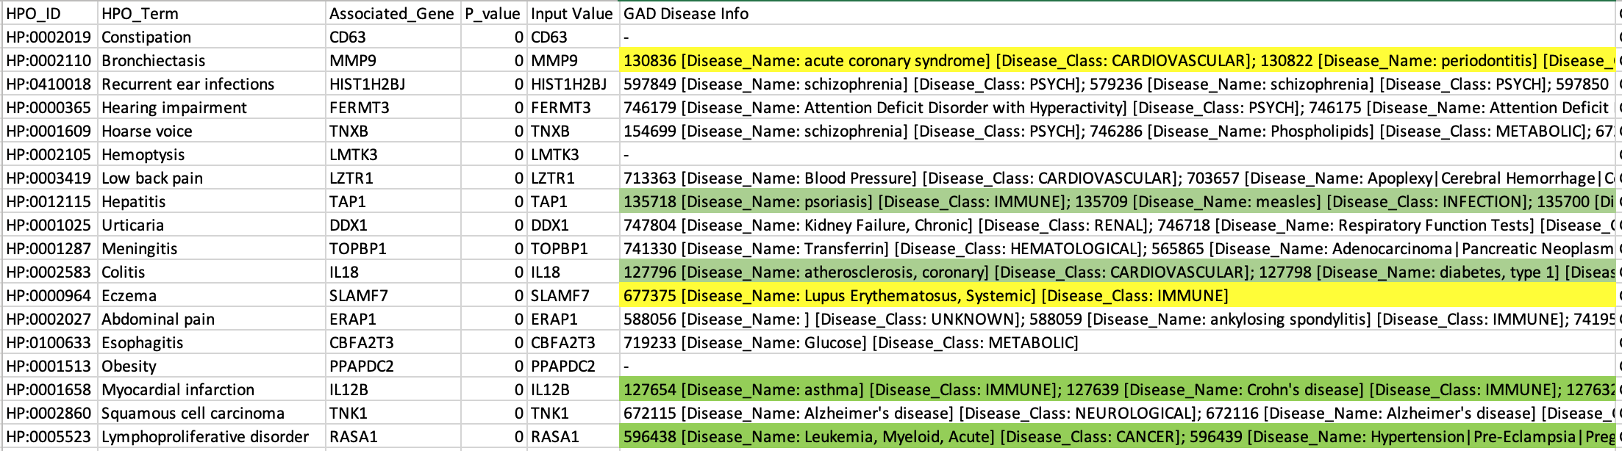
Exploring these associations
Notes:
Yellow = Close disease match
Green = Exact disease match
Justin put together a whole spreadsheet for the top gene/term associations and just went through some of them.
How:
Input all the Genes that had p_value = 0 on the previous slide into BioDBNet and looked for diseases that matched the HPO Terms.
Just looking at a few of the results, we can see that some of these associations may be legitimate

Slide 20
There’s potential here…
Need increased sample size and the ability to compare to literature/databases
Provides a different way to examine phenotype/genotype associations in a rare disease cohort
Suggestions?

Slide 21
VCF Concordance
Need an automated way to find when a sample’s genotype information has changed significantly between joint genotyping runs
Issue:
Joint genotyping was re-done
Physician noticed that a previously pathogenic tagged variant went away
Data may have been placed with the wrong ID in the new msVCF

